Slide 1














The mystery of the missing cake

Slide 2




A messy kitchen
An empty cake stand
Frosting on the floor

Slide 3

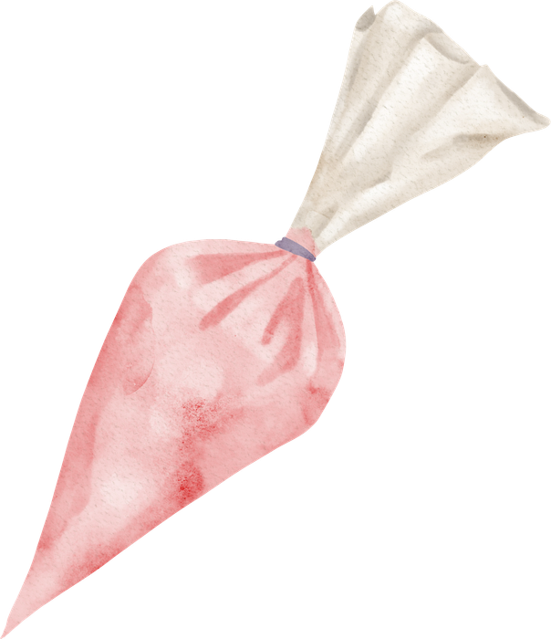
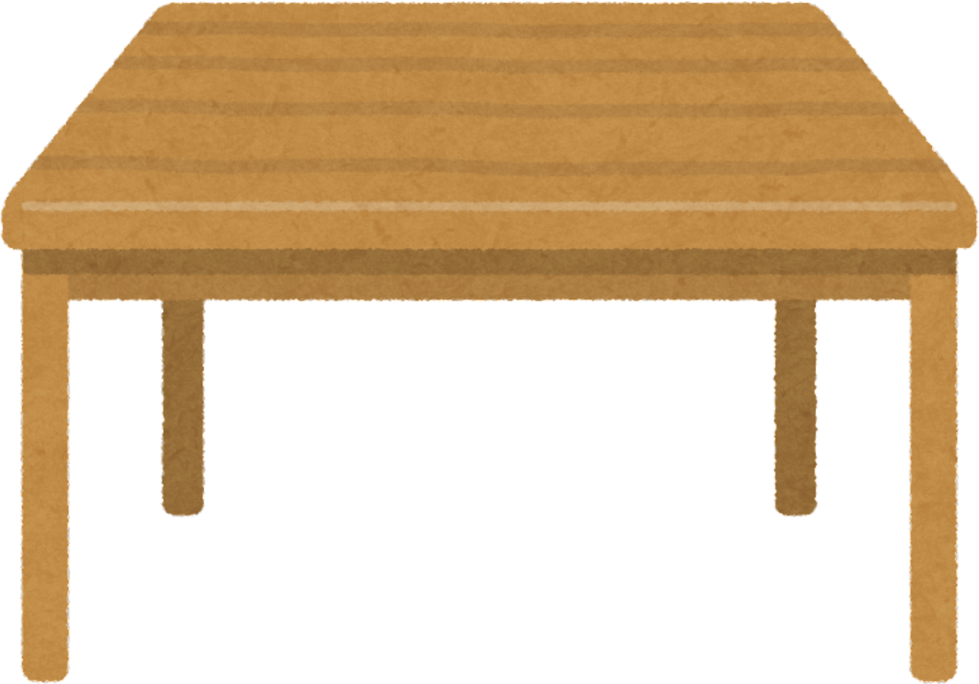


It’s a case for detectives
Al. E By and
I.C. Cake

Slide 4
What happened?
Someone stole the birthday cake at 6:00 p.m. yesterday.

Slide 5



Meet the suspects
Max is very serious and always says he is “studying.” Always.
But he once wrote an essay about chocolate cake instead of history.

Slide 6

Meet the suspects
Lucy loves talking on the phone and posting photos on social media.
She says she doesn’t even like cake… but she took three photos of it before it disappeared.

Slide 7
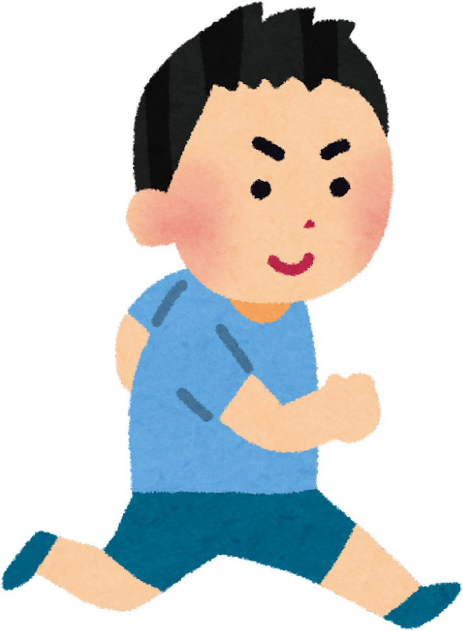
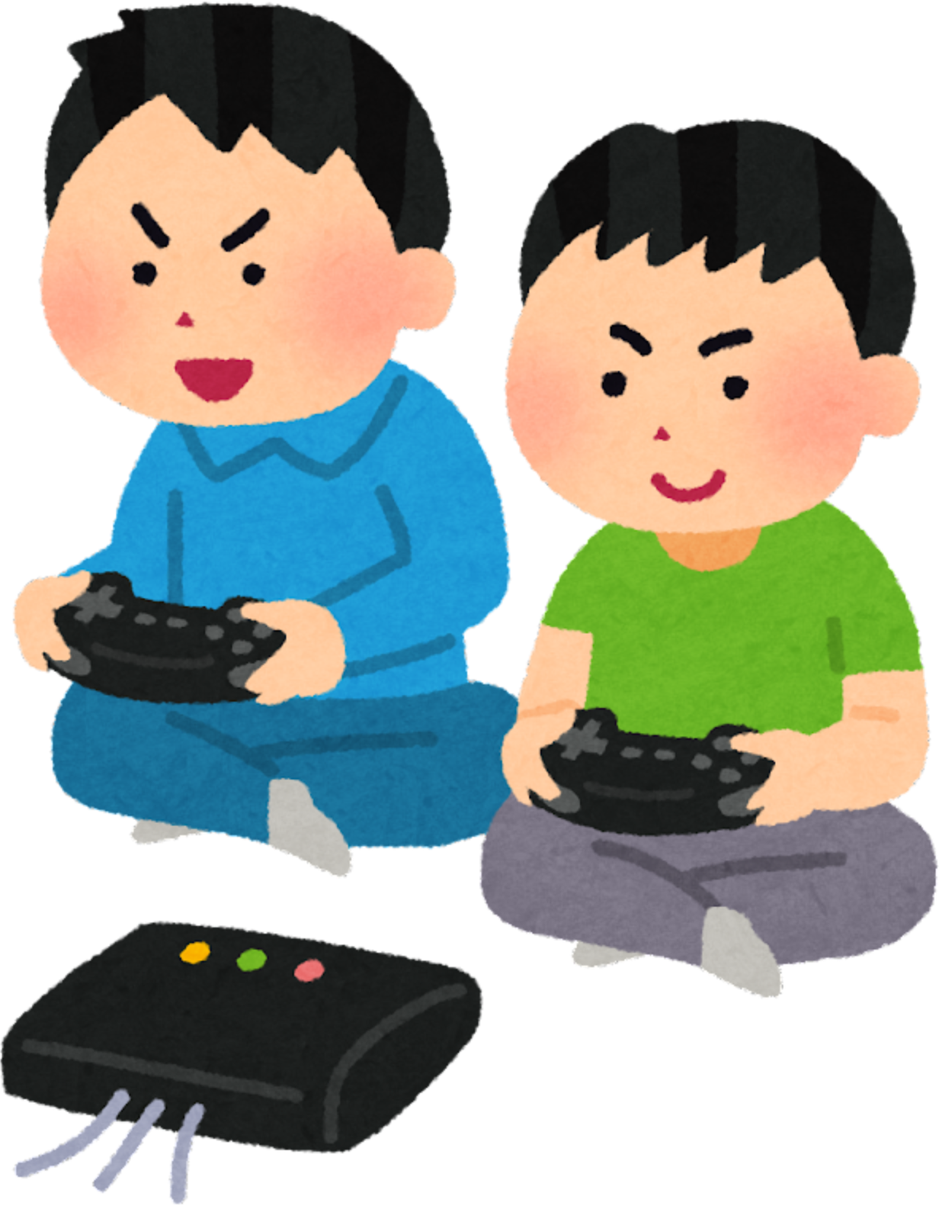
Meet the suspects
The twins have a serious sweet tooth. They say they only eat “one small piece”… but somehow the whole cake disappears.
They were very excited about the party. Too excited.

Slide 8


Meet the suspects
Bruno is very friendly… and always hungry.
He LOVES cake.
His tail moves very fast when he sees dessert.

Slide 9

Interrogating the suspects
What were you doing at 6:00 p.m. yesterday?

Slide 10

I was studying at 6:00 p.m. yesterday.

Slide 11
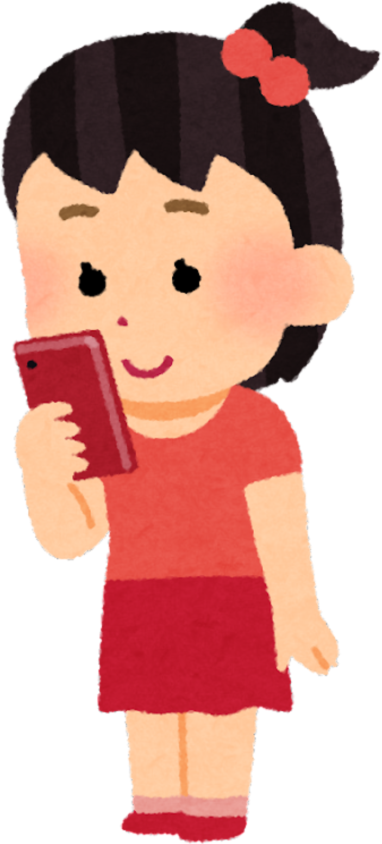
I was talking on the phone at 6:00 p.m. yesterday.

Slide 12
We were playing video games at 6:00 p.m. yesterday.

Slide 13

Well, Bruno can’t speak but apparently, it was sleeping at 6:00 p.m. yesterday

Slide 14
Identify the verbs in the sentences
I was studying at 6:00 yesterday.
I was talking on the phone.
We were playing video games.
The dog was sleeping.

Slide 15
Identify the verbs in the sentences
I was studying at 6:00 yesterday.
I was talking on the phone.
We were playing video games.
The dog was sleeping.

Slide 16


Past continuous
WE USE THE PAST CONTINUOUS TO TALK ABOUT...
actions that were in progress at a specific time in the past
interrupted actions or simultaneous actions, with emphasis on the duration
background scenes

Slide 17
Past continuous
Subject
Subject
To be
Verb
-ing
I
He
She
It
was
Affirmative
study
-ing
We
You
They
were

Slide 18
Past continuous
Subject
Subject
To be
Verb
-ing
I
He
She
It
wasn’t
(was + not)
Negative
study
-ing
We
You
They
weren’t
(were + not)

Slide 19
Past continuous
Subject
To be
Subject
Verb
-ing
I
he
she
it
Was
Question
study
-ing?
we
you
they
Were

Slide 20
Your turn!
Write down the follow-up question the detectives asked each suspect. Answer the question.
What
?
Maths.

Slide 21
Your turn!
Write down the follow-up question the detectives asked each suspect. Answer the question.
Who
?
to Mia.

Slide 22
Your turn!
Write down the follow-up question the detectives asked each suspect. Answer the question.
What
?

Slide 23


Your turn!
Write down the follow-up question the detectives asked each suspect. Answer the question.
What
?
It

Slide 24
Magic shortcuts
use in presentation mode
B: blur current slide
C: confetti rain
D: drumroll
M: mic drop
O: bubbles
Q: quiet
U: curtain
0-9: timer

